Slide 1
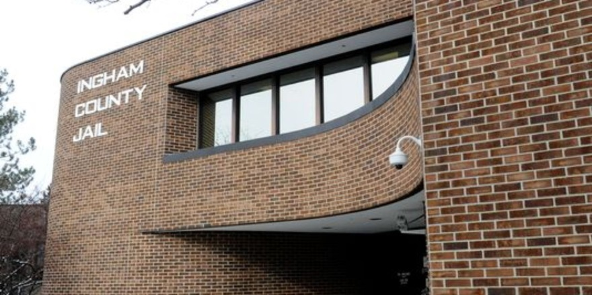
the Ingham county Sheriff’s office & Ingham county correctional facility
Scott Wriggelsworth – Sheriff
Andrew Bouck - Undersheriff

Slide 2
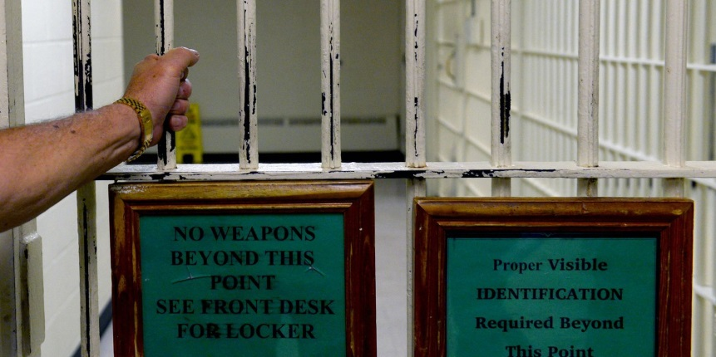
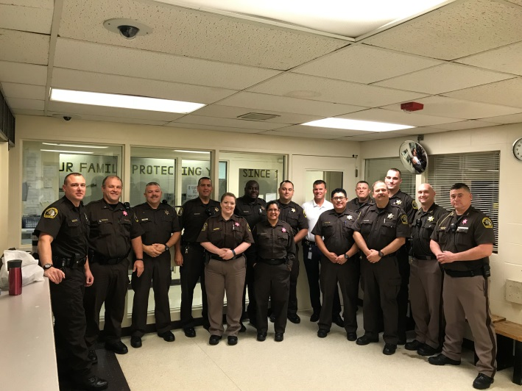
Understanding What We Do
Jail versus Prison
- PRISON:
Inmates sentenced to more than
one year of imprisonment.
39 State Prisons
- JAIL:
From time of arrest up to and
including sentencing
83 Counties in the State of Michigan,
each having their own jail. Separate
and independent, run by each county Sheriff

Slide 3
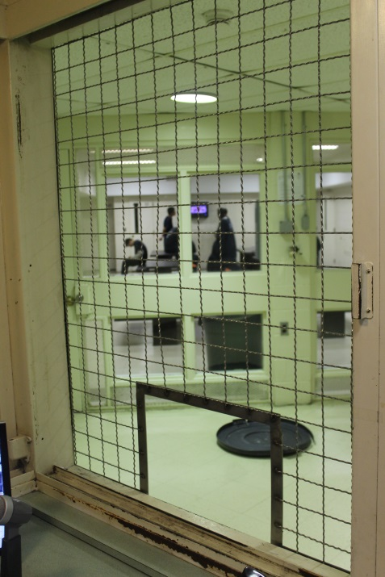
Who’s in Jail?
-Jail holds all pre-trial detainees.
- Waiting Arraignment
- Waiting Trial
- Unable to Post bond
Sentenced to less than 1 year of Jail time
- Sentences over 365 days are sent to Prison (Michigan Department of Corrections)
Charges
- We hold all Ingham County criminal charges
From Murder, First Degree (Premeditated)
To Civil - Failure to Pay Child Support
Notes:
MDOC has a separate facility for each type of offender. Mental Health, Medical issues, Low security, Youthfuls, Juveniles, females, low security, medium security, Maximum Security. County Jail has everyone of these types of prisoners.
When inmates arrive at MDOC, they usual have screening for mental health and medical issues, and typically is on medications. Jails – Just off the streets.

Slide 4
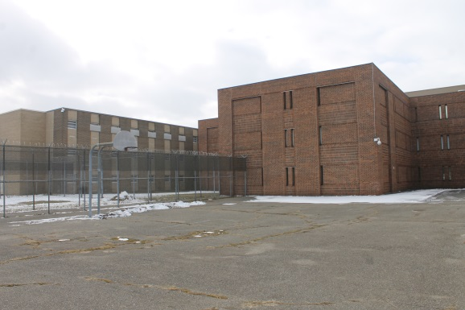
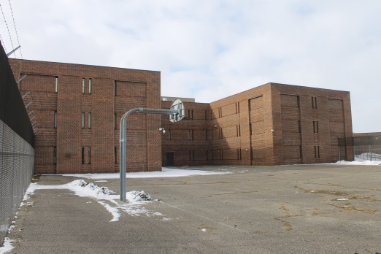
By the Numbers
Inmates processed
2017: 8,606
2016: 8,765
2015: 9,590
2014: 9,833
Sentenced v. Un-Sentenced
54% Un-Sentenced
34% Sentenced
12% MDOC
Age Breakdown (2018)
17 4 (1.75%)
18-25: 62 (27.1%)
26-35: 78 (34.1%)
36-45: 48 (20.9%)
46-55: 29 (12.7%)
56- +: 8 (3.5%)
Total Bond Transactions (2017)
6,128 transactions. $625,966
Average length of Stay
21 Days
Cost to house an inmate
$78.68 per day
(MDOC pays us $36 a day)
Notes:
Average of 10,000 people come through our doors every year

Slide 5
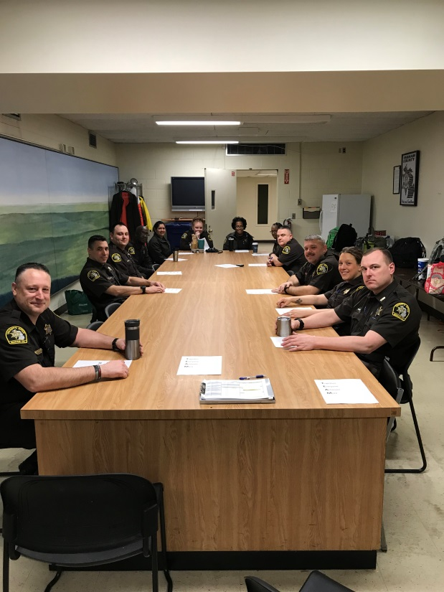
Daily Staffing Levels
Weekday:
2 – Command Officers
1 - Receiving Lieutenant
6 - Post Deputy (1 for each Housing Unit)
3 – Booking/Receiving Deputies
1 – Classification Deputy
1 - Security Deputy
1 - Education Security
1 – Medical Security
1 – Inmate Worker Coordinator
= 17 Deputies to run the Jail
Weekends:
1 – Command Officer
6 - Post Deputy (1 for each Housing Unit)
2 – Booking/Receiving Deputies
1 – Classification Deputy
1 - Security Deputy
=12 Deputies to run the Jail

Slide 6
Jail Capacity
Current: 444
Local: 394
MDOC: 50
High of 665 (2004)
Local: 472
MDOC: 193
Closed Post 3, new count 601 (2011)
Closed Post 6, new count 569 (2016)
Closed Post 7, new count 512 (2016)
Closed Post 4, new count 444 (2017)
*Cause: Reducing MDOC inmates, Expansion of Jail Diversion programs
Notes:
Bed allocation is 444
Numbers fluctuate

Slide 7
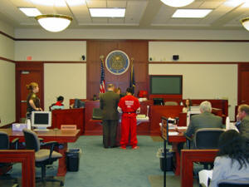
Courts
30th Circuit Court
(9 Circuit Court Judges)
55th District Court (2nd class District Court)
(2 District Court Judges)
Covers Delhi, Meridian and Lansing Townships; Cities of Mason, Leslie,
Stockbridge, Williamston, Webberville, all other townships
54A District Court (3rd class District Court)
(4 District Court Judges)
Covers City of Lansing
54B District Court (3rd class District Court)
(2 District Court Judges)
Covers City of East Lansing and Campus of MSU
Typically transport between 20-50 inmates a day to court appearance
Notes:
30th Circuit Court = Felony cases

Slide 8
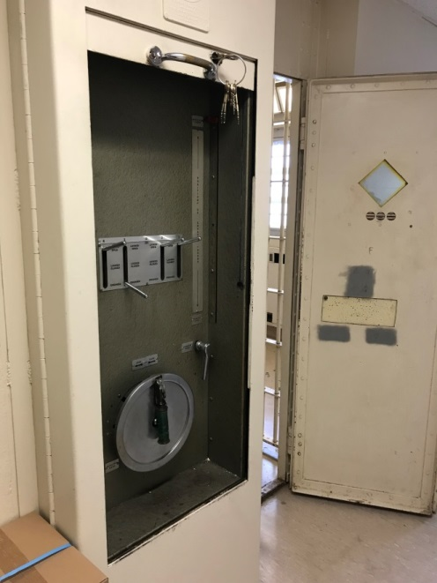
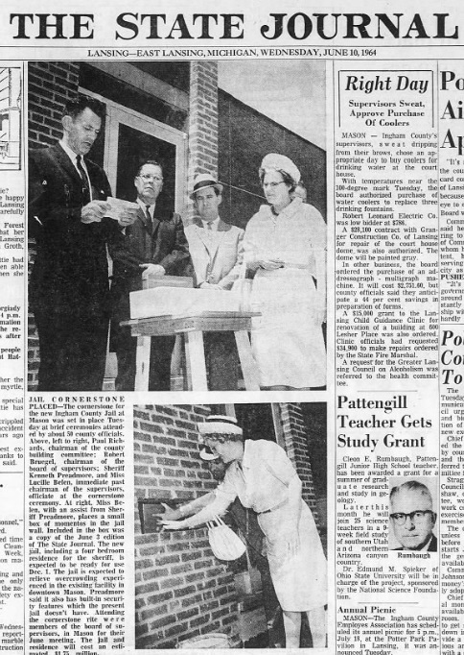
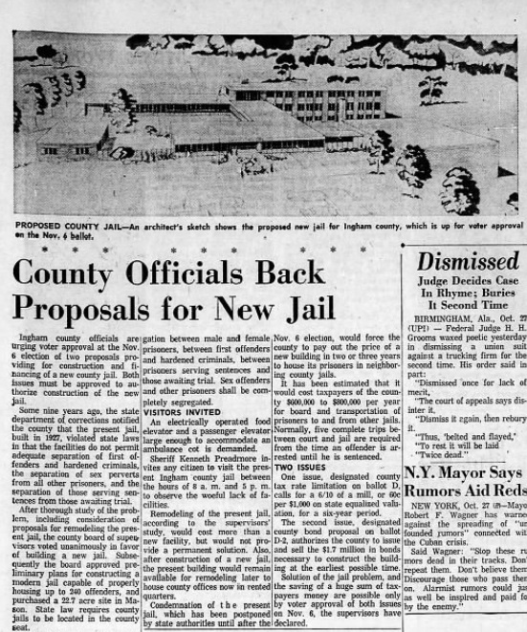
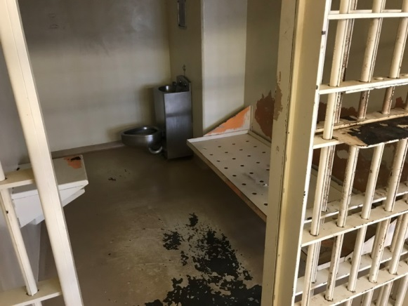
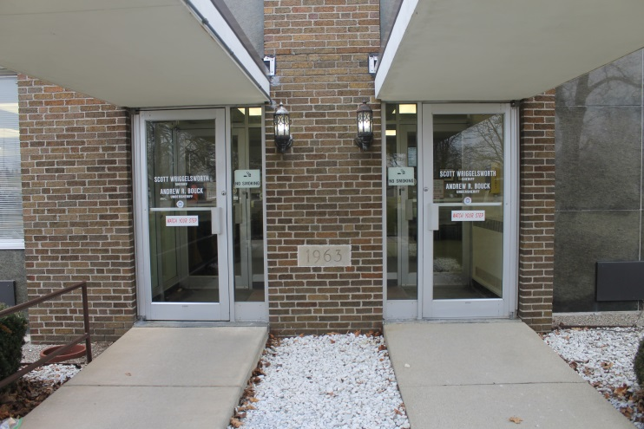
HISTORY
1960s
Prior to 1962s, original Jail was in downtown Mason
New facility was built and STILL IN USE TODAY.
(Linear Jail: Post 3, Post 6, Post 9)
Interesting fact: Our Jail is the
Oldest Large Jail still in use in Michigan.
7th oldest out of all Jails in the State.
Notes:
1960: John F. Kennedy was President; John Swainson was Governor; Ken Preadmore was Sheriff
Prior to 1962: Jail was located at: 142 East Ash Street; 125 East Oak Street; East Maple Street

Slide 9
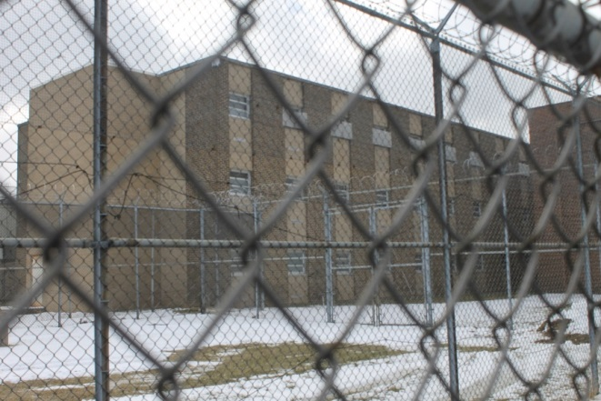
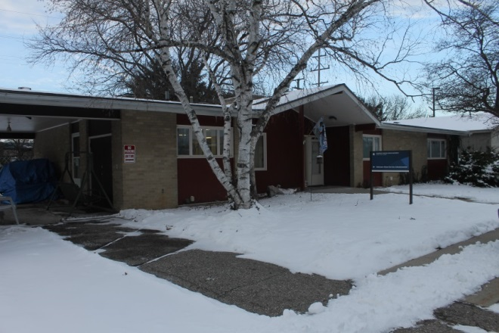
Lansing State Journal 1964
CMH Administrative building
Notes:
Cost of about 2 million dollars (Almost 15 million in today’s dollars)

Slide 10
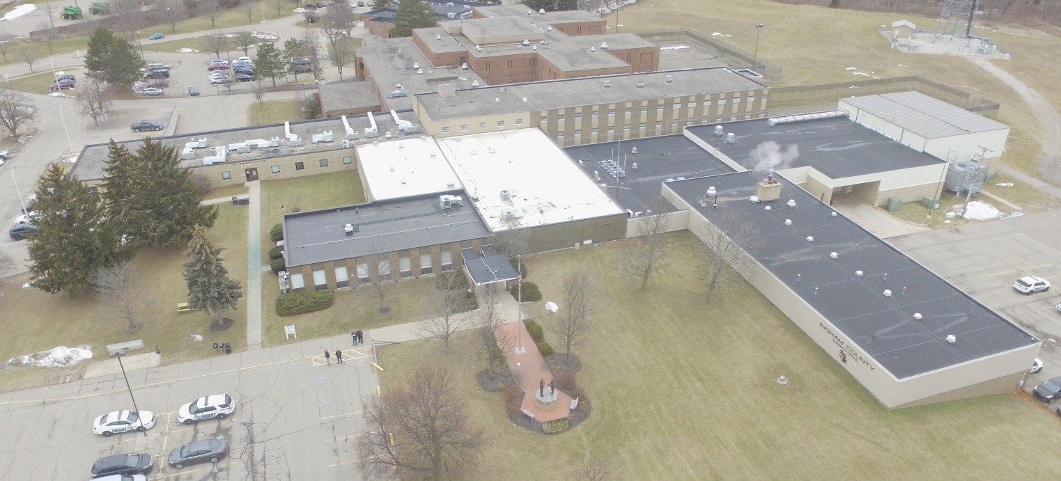
1964
TODAY

Slide 11
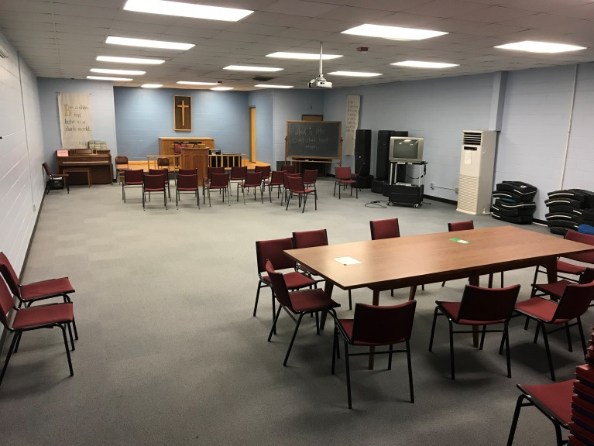
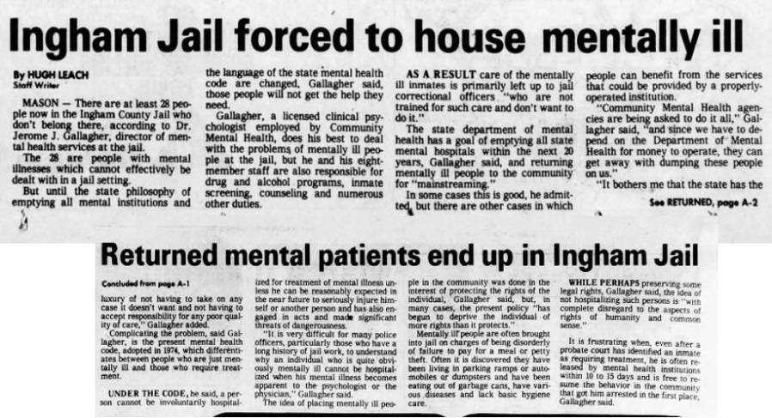
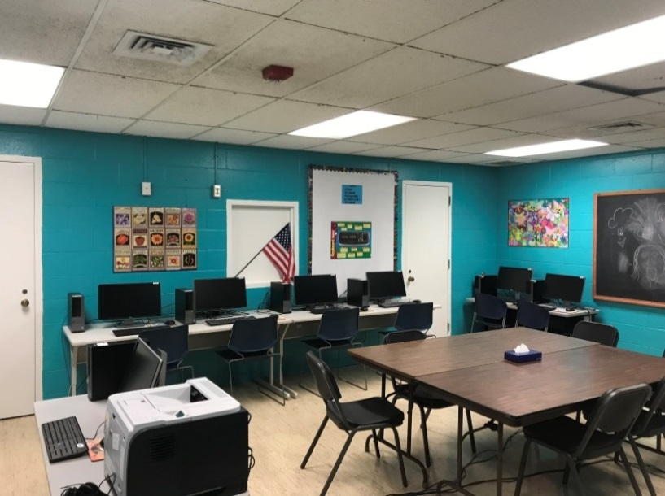
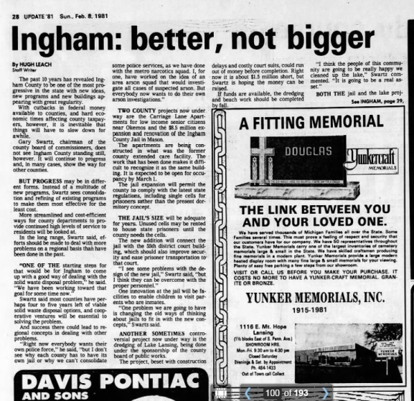
1980s
Major addition to Jail with required Education, Medical, Recreational programs
(Post 1, Post 2, Post 4, Post 5, Post 7, Post 8)
Notes:
25 years later, we added on. (Almost 40 years ago)
Ronald Reagan was just sworn in as President; William Milliken was Governor; Allan Davis was Sheriff

Slide 12
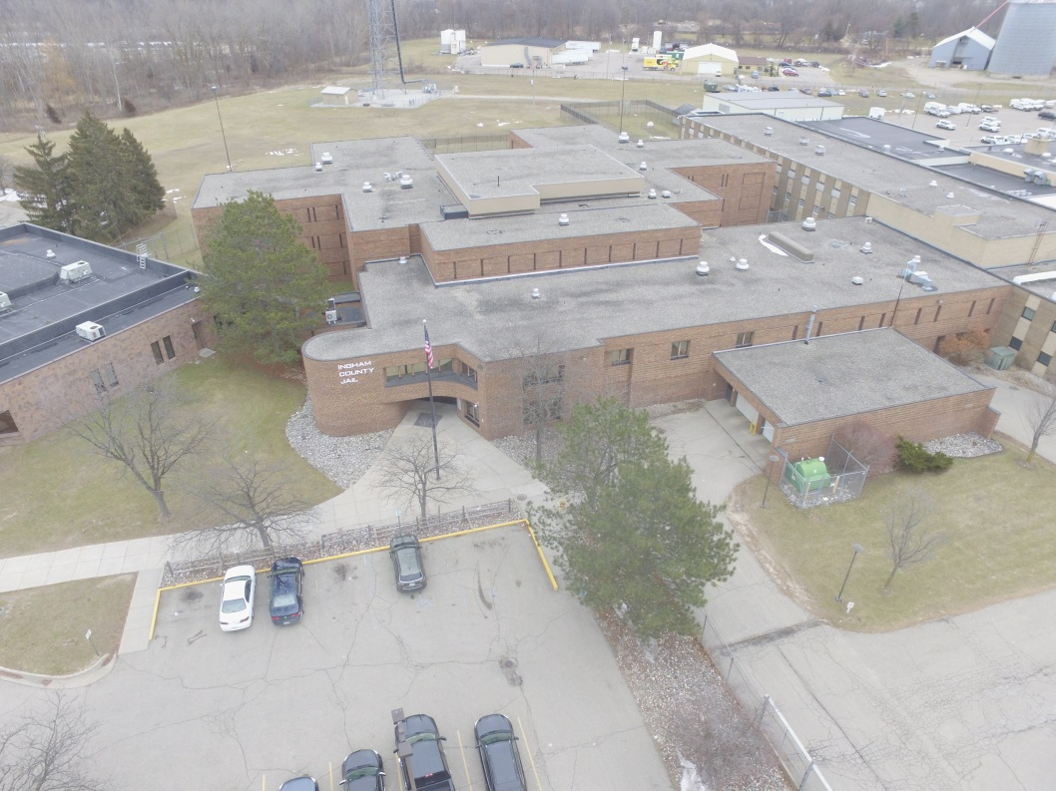
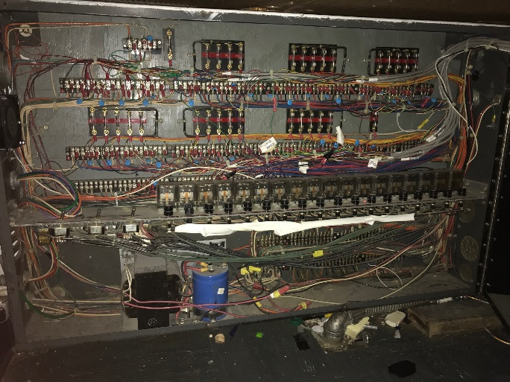
1980 Lansing State Journal
TODAY
Notes:
3rd floor was added.
20.2 million dollar expansion. (57.7 million dollars in today’s money)

Slide 13
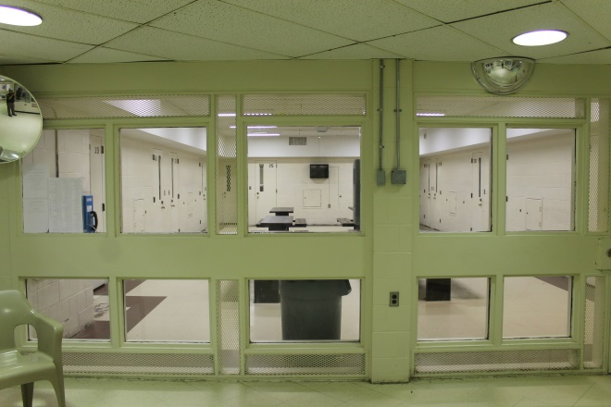
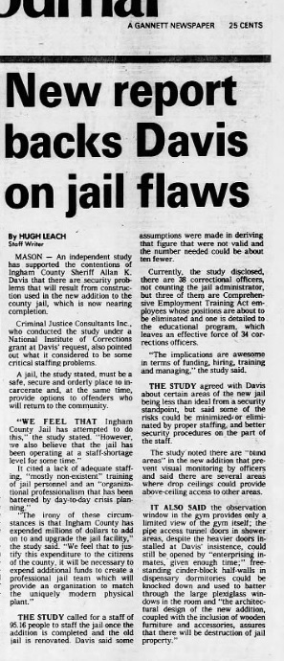
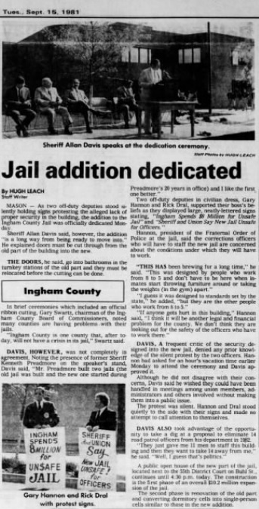
Notes:
September 1981, the new addition was opened. Added 423 beds to the facility

Slide 14
Ingham County Jail hasn’t changed much in almost 40 Years
Notes:
Top: Fingerprints by ink. New AFIS computerized fingerprints that can get a confirmation on prints within 5 minutes from Michigan State Police and FBI
Bottom: Receiving/booking area

Slide 15
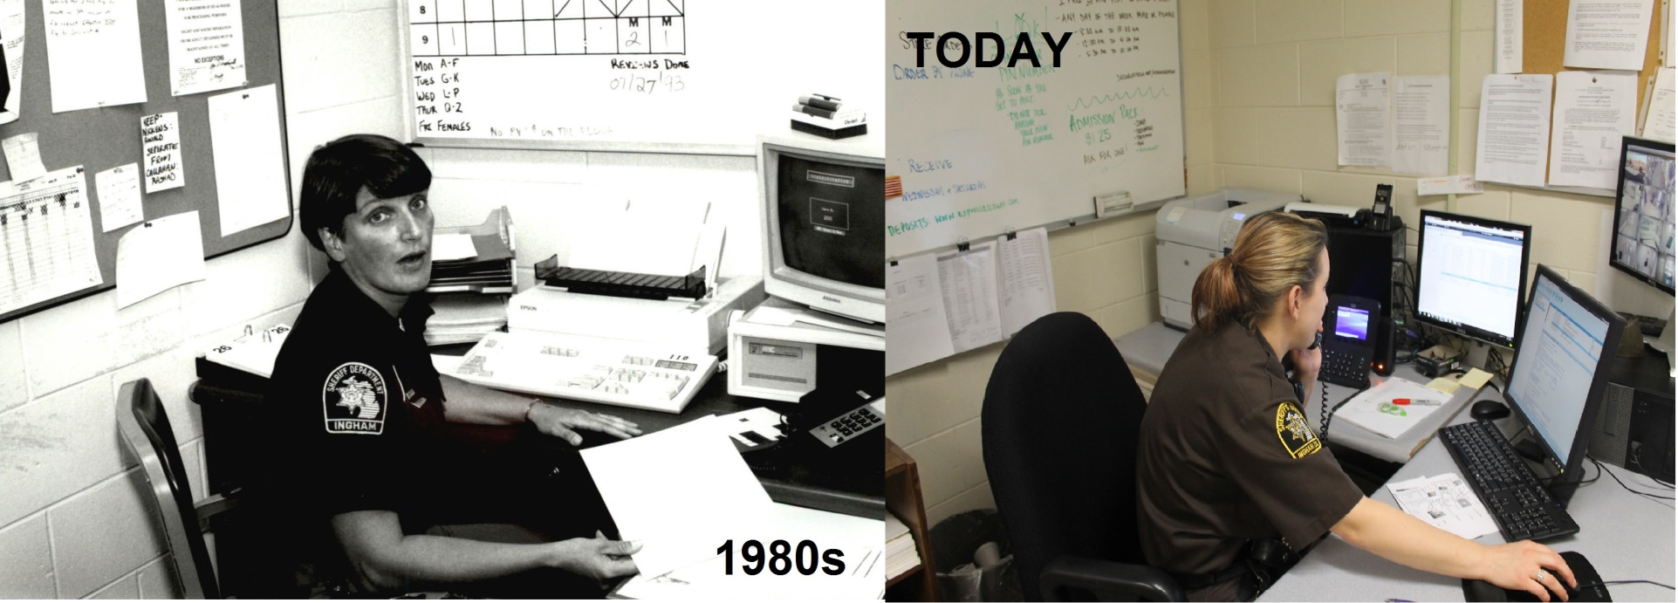
Notes:
Top: Booking area
Bottom: Classification Office

Slide 16
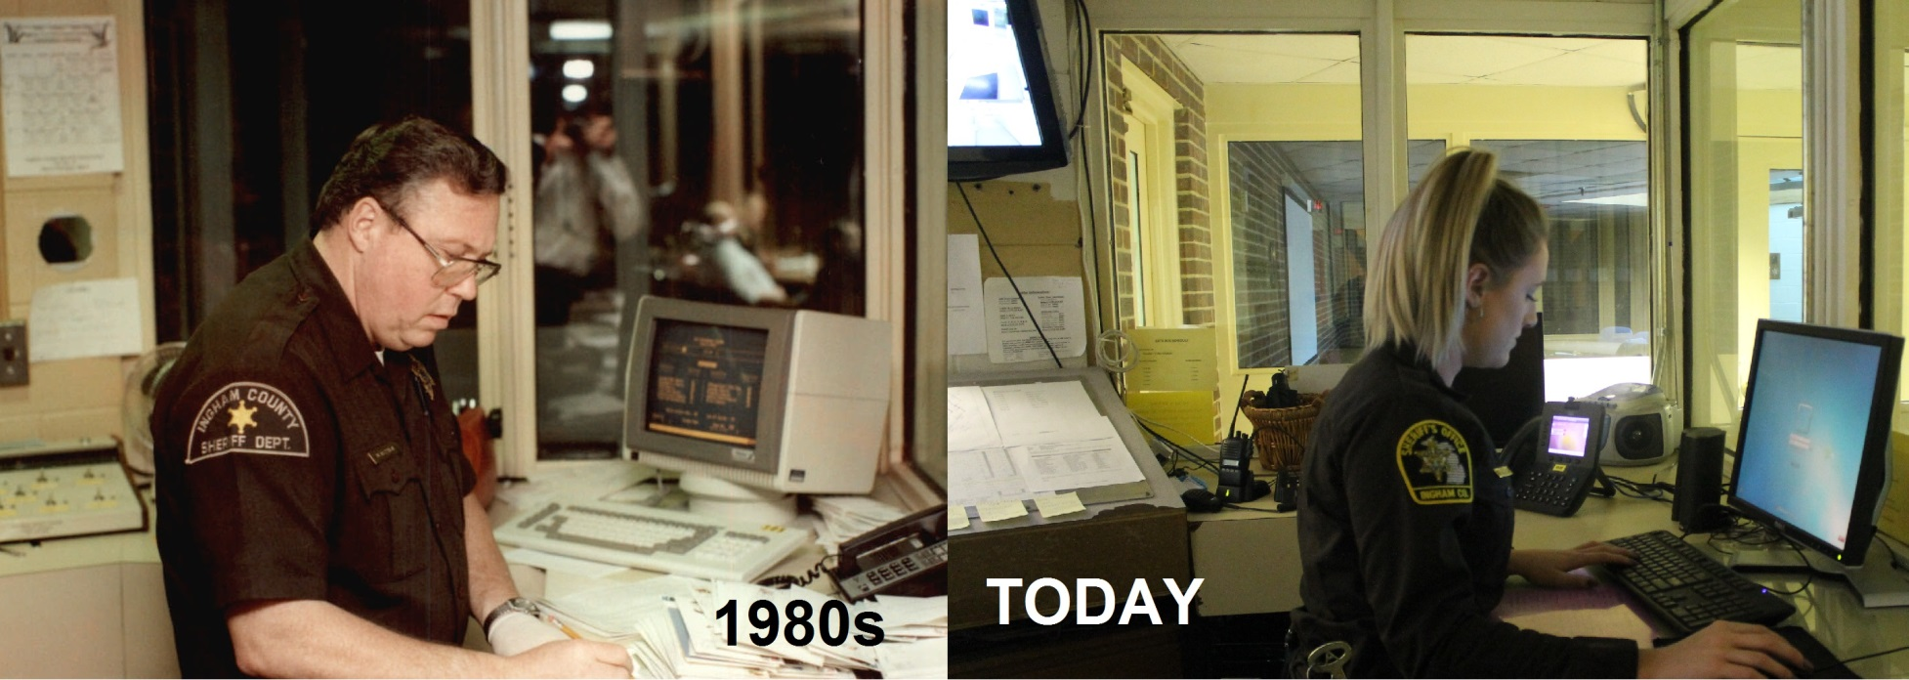
Notes:
Top: Booking area
Bottom: Lobby control area

Slide 17
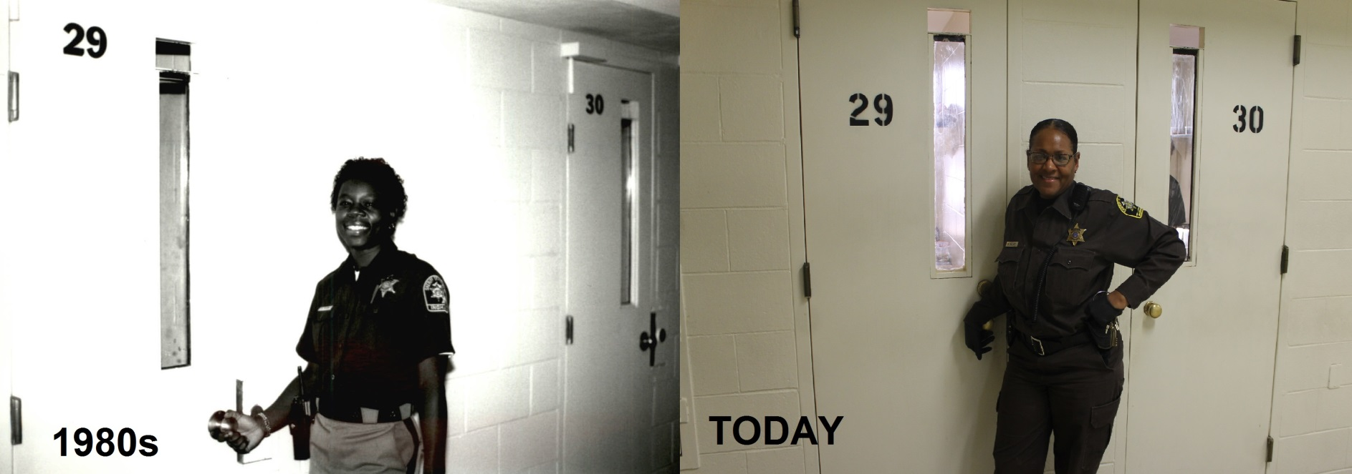
Notes:
Top: Booking area
Bottom: Housing area still in use today

Slide 18
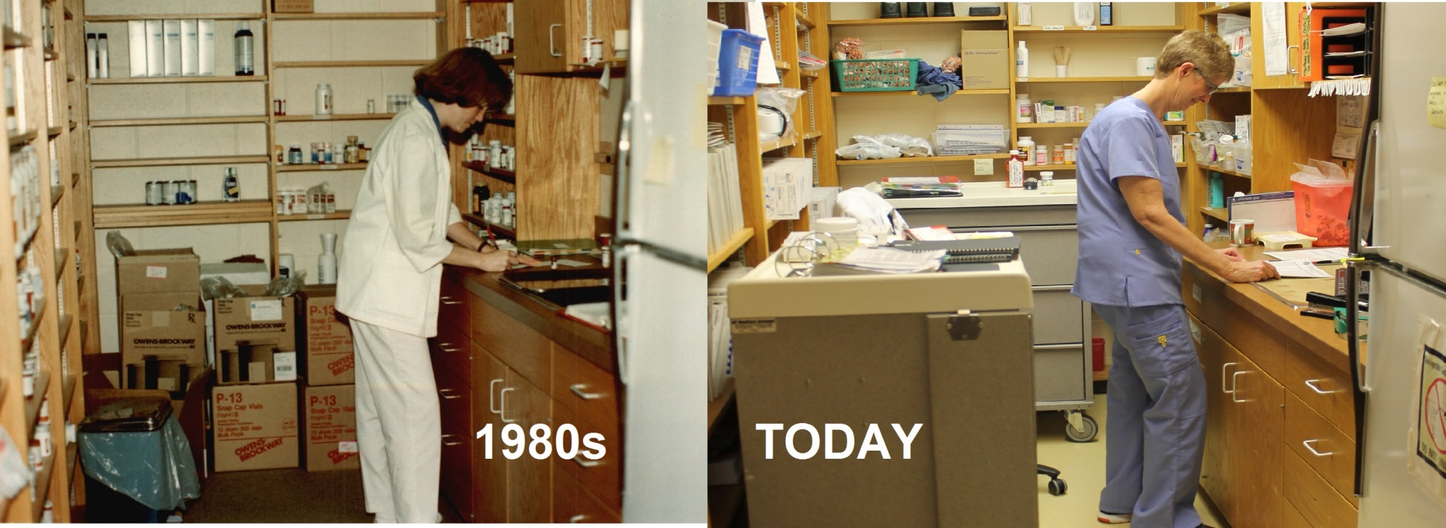
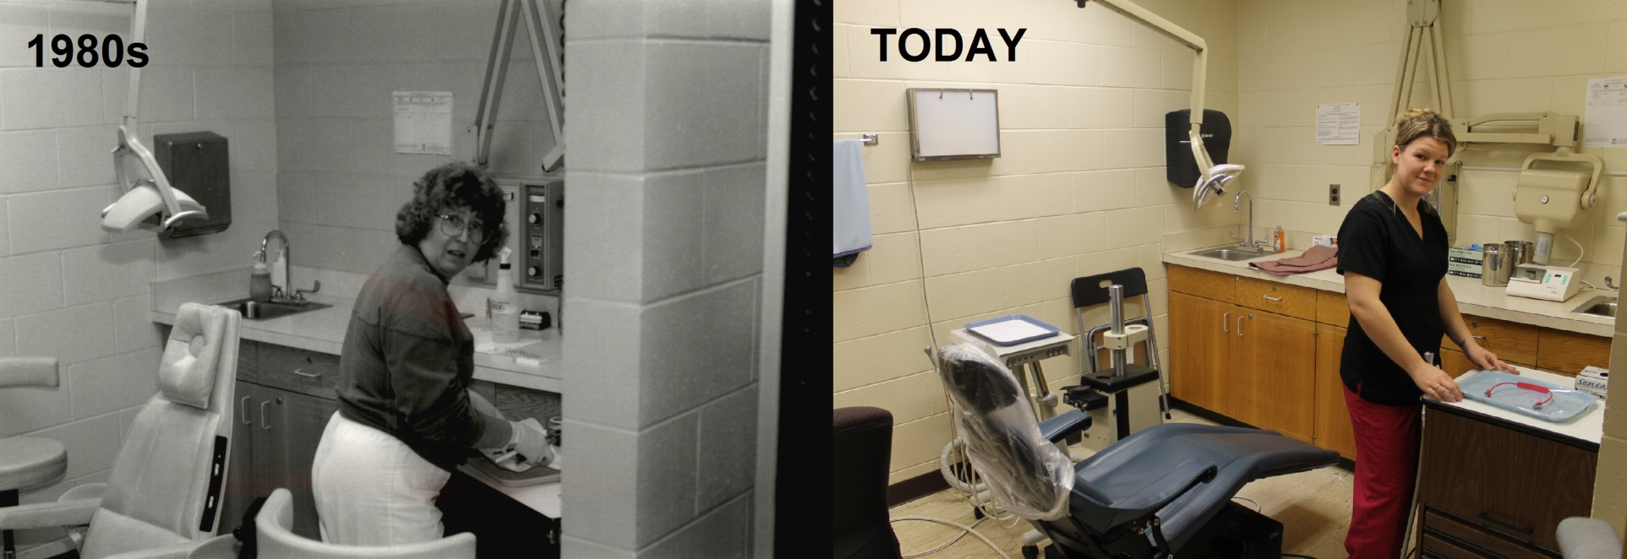
Notes:
Top: Medication room in Medical. Same fridge
Bottom: Dentist area. Same x-ray machine, examine light and cabinets

Slide 19
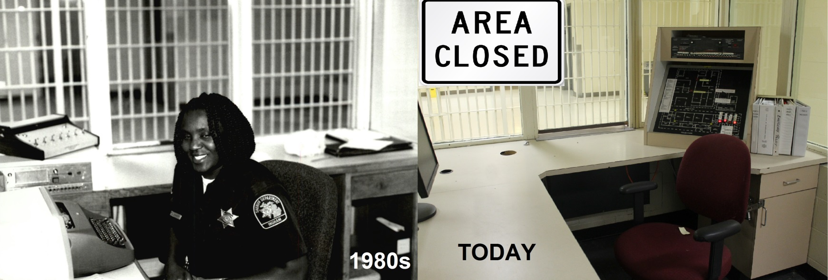
Notes:
Top: Post 4
Bottom: Post 3

Slide 20
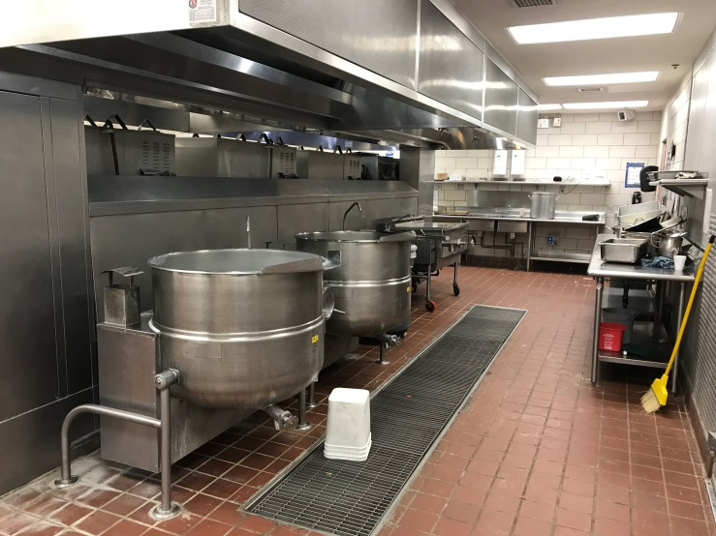
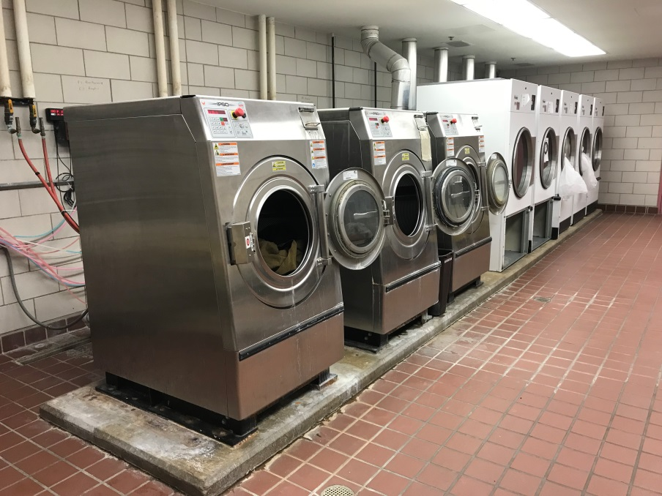
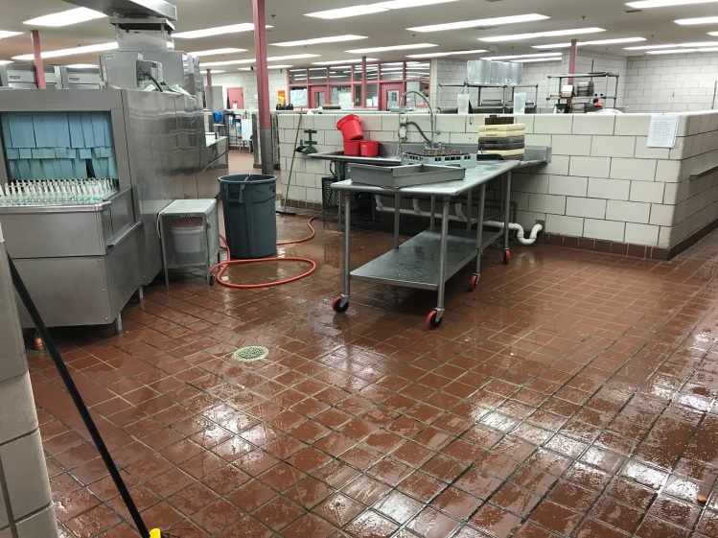
2001
State-of-the art Kitchen added
(Now 17 years old)
Was designed to feed up to
1,000 inmates 3 times a day.
Notes:
20 years before next Major update.
Plans to keep kitchen to cut down on building costs

Slide 21
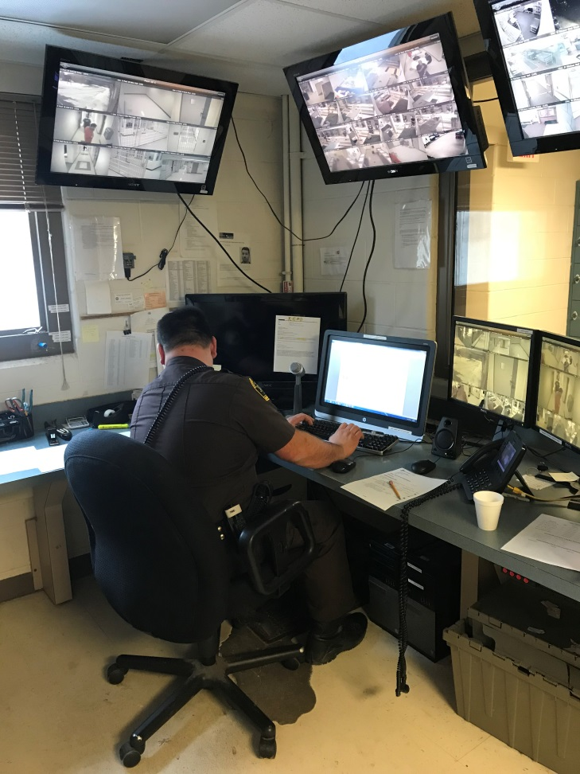
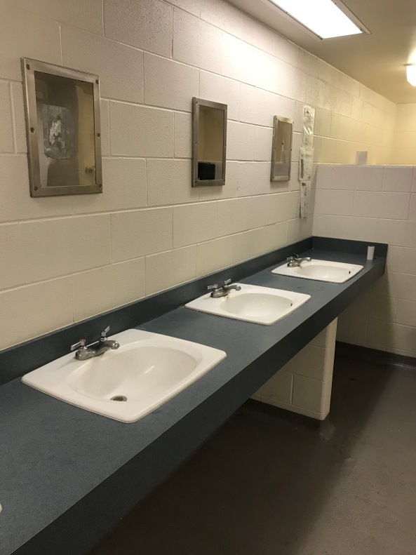
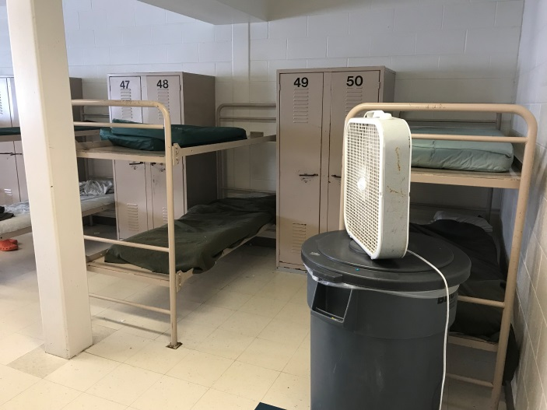
2004
Renovated old Jail Kitchen and Booking area into Work Release and Training Facility
(Post 10) (14 years ago)
Notes:
Meant for work release, but now used for inmate workers and sentenced workers

Slide 22
Why do we need a new Criminal Justice Complex?
1981 Dodge Aries
1962 Oldsmobile Super 88

Slide 23
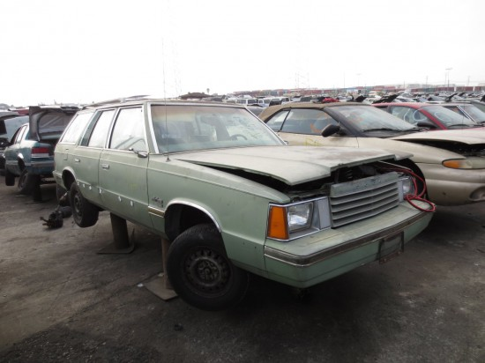
Here’s Why
Approx. 672,000 Miles
Approx. 444,000 Miles
Notes:
1962 Oldsmobile 88; 1981 Dodge Aries
@ rate of 12,000 miles per year

Slide 24
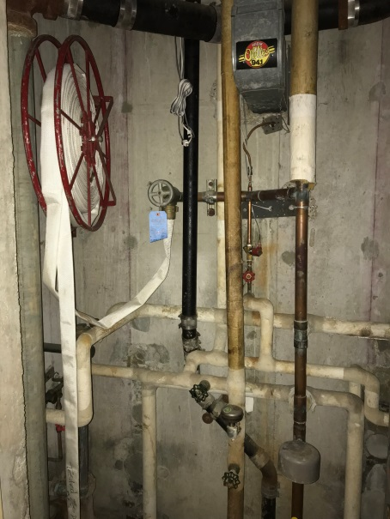
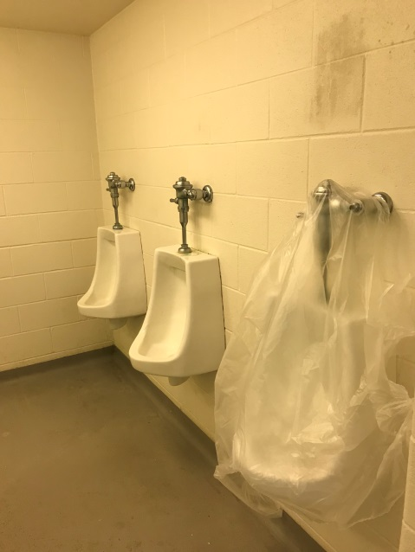
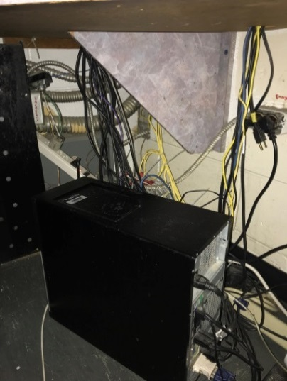
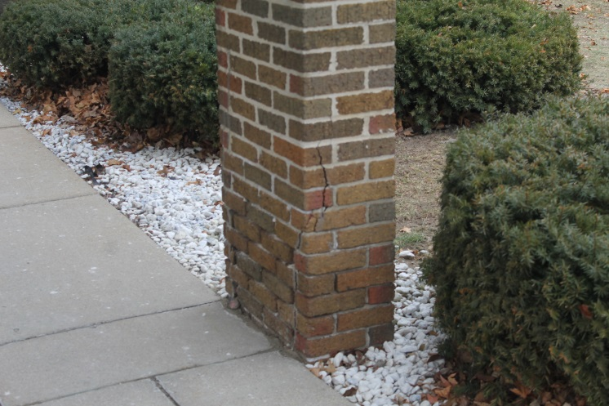
Why Now?
Just like in 1960 & again in 1980, the building is outdated and desperate need of repair. (2,450 maintenance work orders in 2017 alone)
- Most parts can’t be order; they have to be manufactured
Immediate Maintenance Needs:
-New roof (Estimate cost: $800,000 to $1,000,000)
- Water lines (Estimate cost: $80,000)
-Sewage line repair (Estimate cost: $50,000 to $100,000)
- Electrical upgrades (Estimate cost: $100,000 to $200,000)
- New Deputy Stations (Estimate cost: $100,000)
- New Door controls (Estimate cost: $170,000 )
- Exterior Security measure replacement (Estimate cost: $10,000)

Slide 25
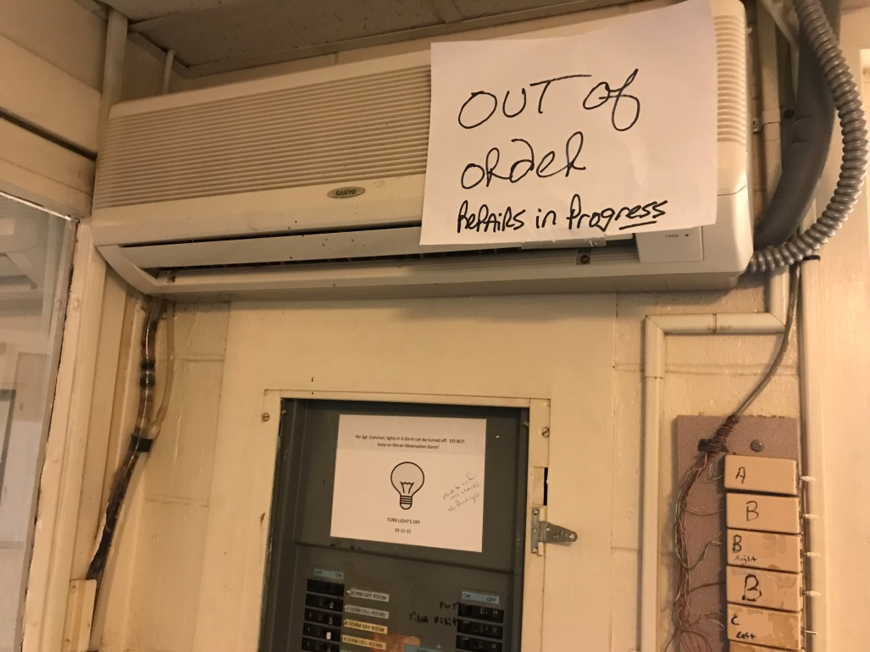
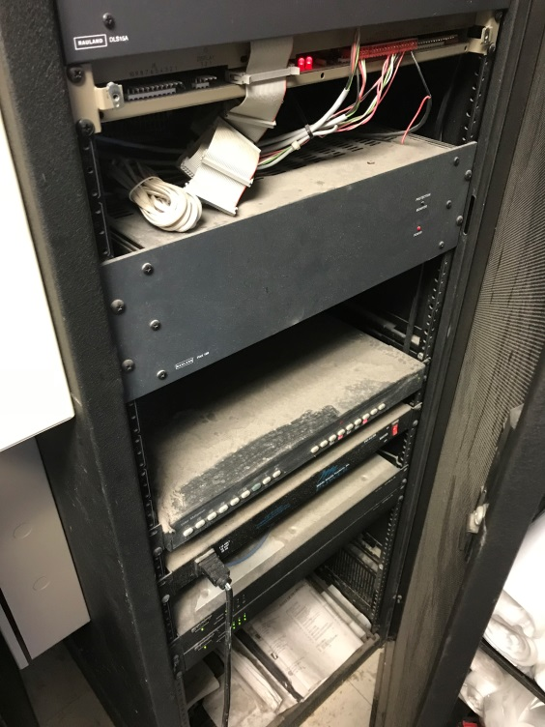
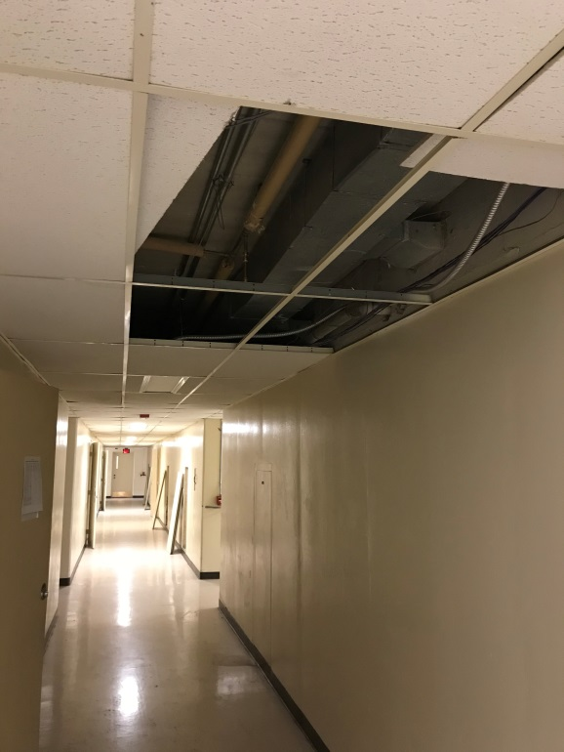
Notes:
Post 4 air conditioner
Radiator on Post 3 or 9
Old door control panels patched to new system
Hallway tiles removed for repair

Slide 26
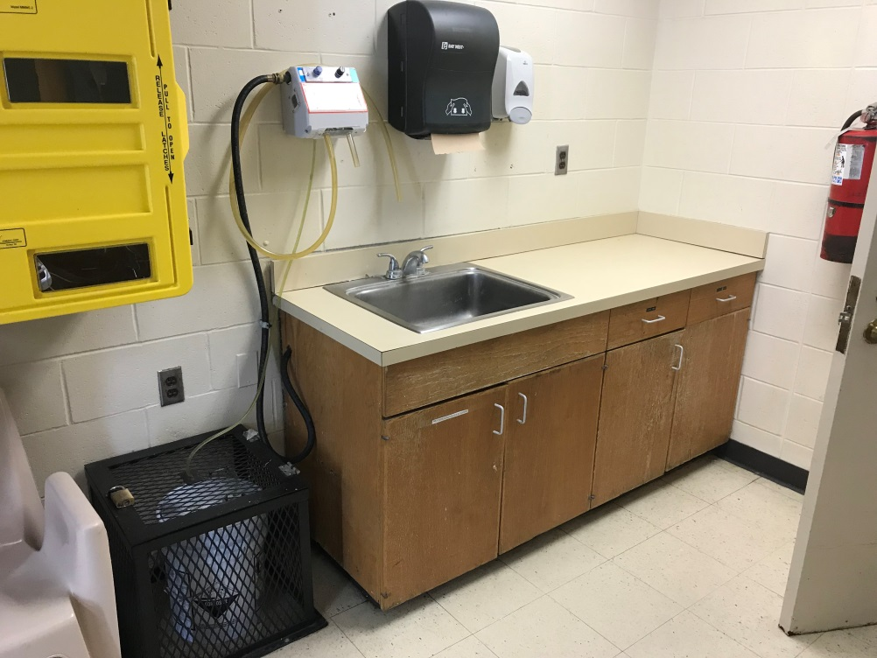
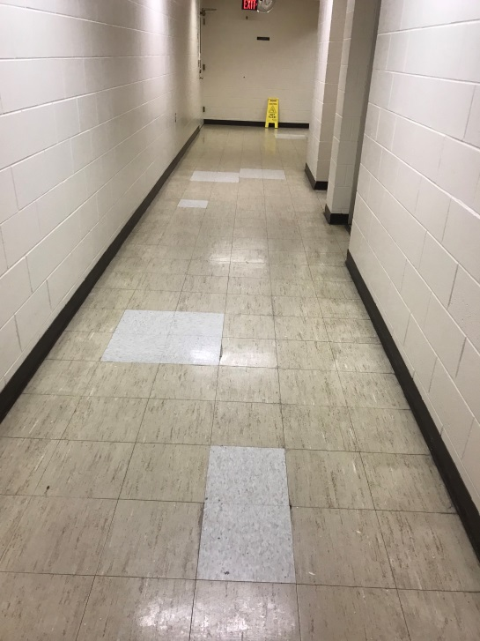
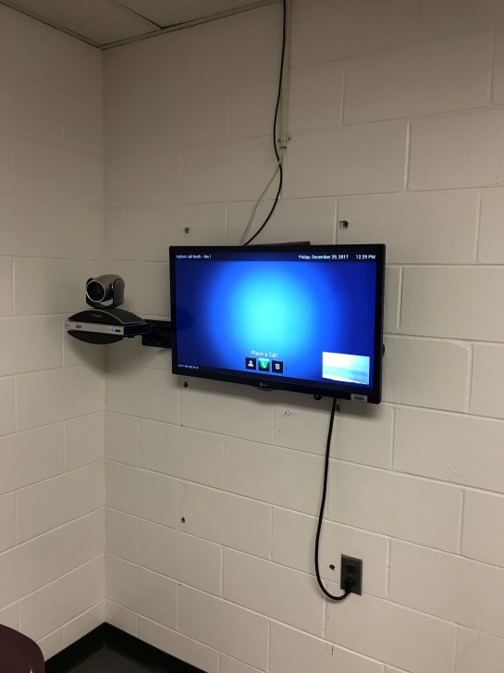
Notes:
Leaking radiators
Cabinet doors falling apart and can’t be used
Deteriorating pipes
Floor tiles coming up; New technology installed but wires exposed

Slide 27
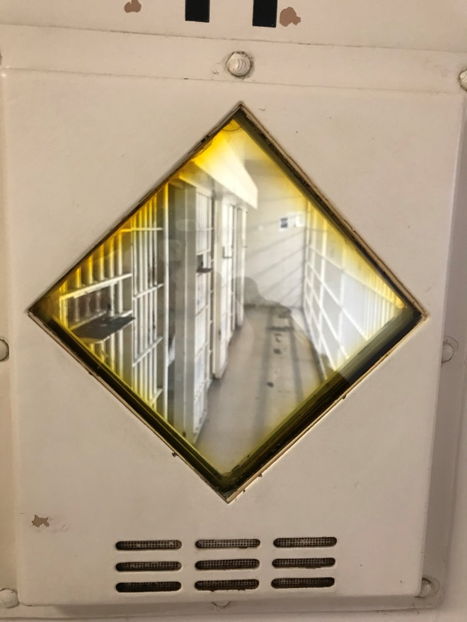
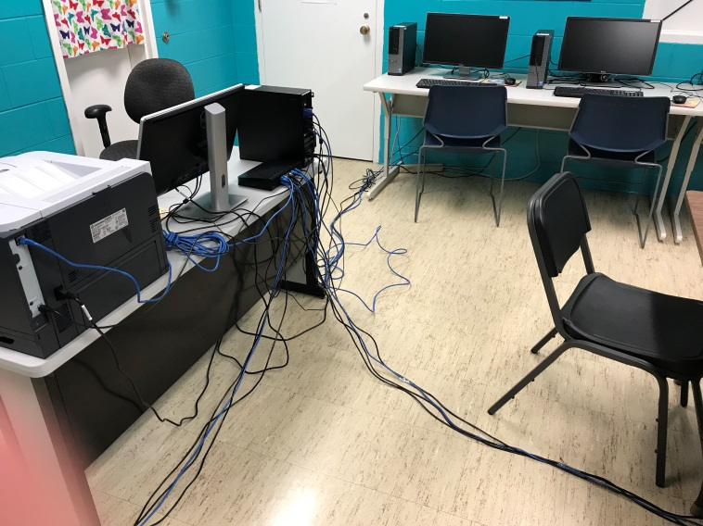
Notes:
Cracks in structure
Old crack locks
Computer cables

Slide 29
Notes:
Deputy work station
Limited sight from Deputy to inmate areas.

Slide 32
Got it on Camera?
First floor housing area, no camera coverage
Notes:
Only 1 small area in A-Dorm
Pretty typical for the entire jail
158 inmates are housed in this area

Slide 33
Changes to Inmate Population
Mental Health Crisis
- One-third of inmates are seriously afflicted, suffering from Schizophrenia, bipolar, and other psychotic disorders
- Detroit Free Press, Nov 27, 2011
Medical Needs
- 367 outside medical appointments in 2017. (Inmate was transported outside of the Jail for evaluation or treatment)
Notes:
As noted at the front end, MDOC has separate prisons for each type of prisoner, but we have to house all types and all ages.

Slide 34
Meth Crisis
Opioid Epidemic
Juvenile inmates
Youthful inmates
Sexual Predators

Slide 35
Educational Program
GED
Alcohol Anonymous
Narcotics Anonymous
Reformers Anonymous
Celebrate Recovery
Anger Management
Men’s Foundation Group
Men’s Motivation Group
Women’s Co-Occurring Group
Men’s Co-Occurring Group
Parenting classes
Bible Study
Catholic Prayer
Restorative Justice
Biblical Life Principles
Group chapel services
Employment skills
CATS/CMH individual sessions
TaiChi (Chi Gung)

Slide 36
Programming
Part of Millage
- Additional Pre-Trial Services staff (Who needs to be in Jail)
- Re-entry Program
- Expanding Electronic Monitoring and day reporting
($6 per day versus $78.68 while in Jail)
- Employment Services
- Vocational Education & Job Training
Correcting behavior vs. Warehousing individuals
- Are they ready to re-enter and be productive member of society?

Slide 37
Overcrowding Programs
EER Program (Earned Early Release)
Inmate worker program
.5 for Inmate worker
.6 For Kitchen worker
.5 CATS days
.5 Thinking Matters/MRT
Automatic Personal Recognizance Bonds
28 day PR for 55th Misdemeanors
14 day PR for 55th Probation Violations
7 day PR for all 54A Misdemeanors
Electronic Monitoring Program – Sentinel tether
Bond Less than $10,000
Completed 50 % of Sentence
Other Programs
JASP – Jail Alternative Sentencing Program (Friend of Court)
DART – Dead Animal Recovery Unit (55th District)
Notes:
Overcrowded for 90 days in 2017
About 100 people on tether

Slide 38
What a New Criminal Justice Complex Looks Like
Livingston County
Muskegon County
Can be as plain or as aesthetic as you want
Notes:
Top left – Livingston
Bottom right – Muskegon County

Slide 39
Modern and Secure
Notes:
Upper left is Muskegon County. Other 3 pictures from Livingston County.

Slide 40
Comparison
Notes:
A cell is a cell. It’s what’s around it and made of that makes the difference.
Notice tile replacement on the floors. Better lighting; less areas to hide contraband

Slide 41
Comparison
Notes:
Ability to shut water off; quick access to mechanical; can find issues before they become bigger issues.

Slide 42
INGHAM COUNTY JUSTICE MILLAGE
Facility Estimated at $70,000,000
.85 mills ($100,000 home will cost you $42.50 a year for 20 years)
A dime a day
AUGUST 7TH

